Slide 1

DriverPass System Analysis
Julrey Solis

Slide 2

System Requirements
Non-functional Requirements
The system must be able to open and run on web-based applications and browsers
The web page should load within 2 seconds considering that internet connection is stable.
Functional Requirements
The system shall apply role‑based permissions to ensure each user only accesses features appropriate to their role.
The system shall generate downloadable reports, including activity logs and reservation schedules.
Notes:
For the DriverPass system, we identified two major categories of requirements: functional and nonfunctional.
Functional requirements describe what the system must do, while nonfunctional requirements define the quality and constraints the system must meet.
Non‑Functional Requirements
First, the system must be fully web‑based. That means it should run smoothly on standard web browsers without requiring any special installations or local software.
This ensures accessibility for all users, whether they’re customers, instructors, or administrative staff. Another important non‑functional requirement is performance.
The web pages should load within two seconds under normal, stable internet conditions. Fast load times are essential for maintaining a positive user experience and keeping the system efficient and responsive.
Functional Requirements
On the functional side, the system must enforce role‑based permissions. Each user (whether a student, instructor, secretary, or administrator) should only have access to the features and data appropriate for their role.
This protects sensitive information and keeps the interface clean and relevant for each user type.
The system must also be able to generate downloadable reports. These include activity logs, reservation schedules, and other operational data that staff may need for tracking, auditing, or planning.
Providing these reports in a downloadable format supports transparency and helps the business operate more efficiently.

Slide 3
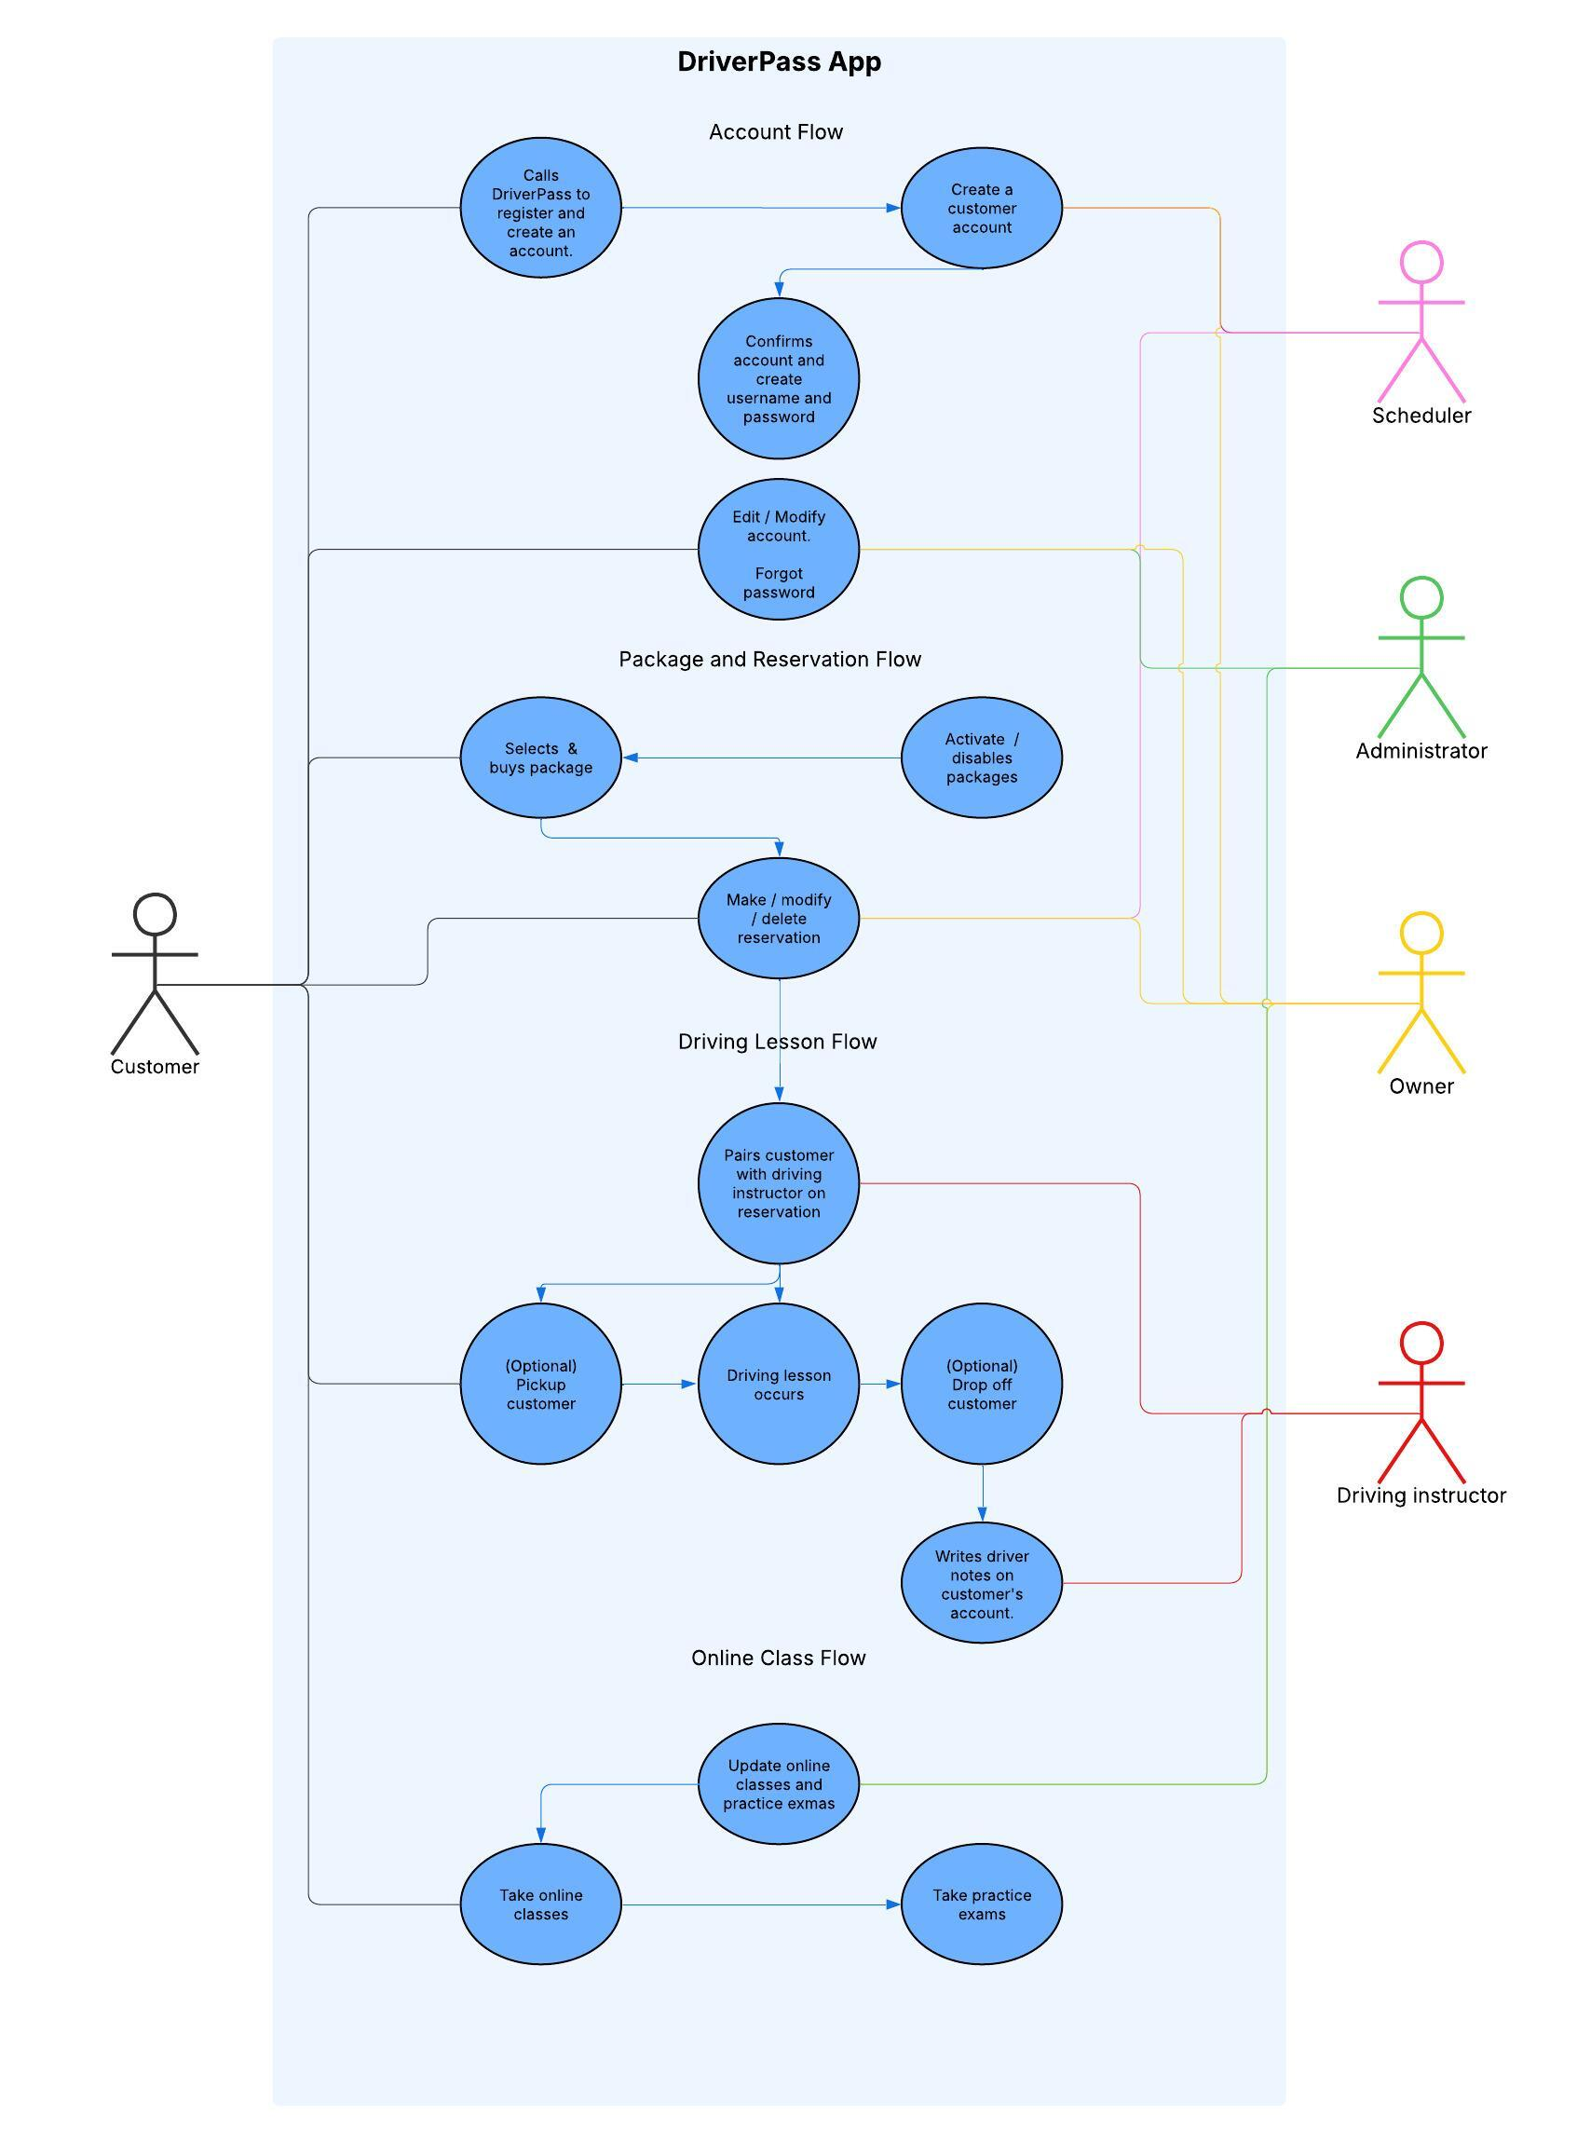
Use Case Diagram
Notes:
This is our DriverPass App. I’ve included 4 major Use Cases which are shown in the Use Case Diagram.
My actors are the main users that will be working on the application.
Customer
Scheduler
Administrator
Owner
Driving instructor
Different Use Cases are:
Account Flow (Creation, to modification)
Package and Reservation Flow (From buying the package up to reserving a driving session)
Driving Lesson Flow (From picking up the customer > Driving lesson > dropping off)
Online Class flow (From updating the course and exam content > online viewing and taking the exam)

Slide 4
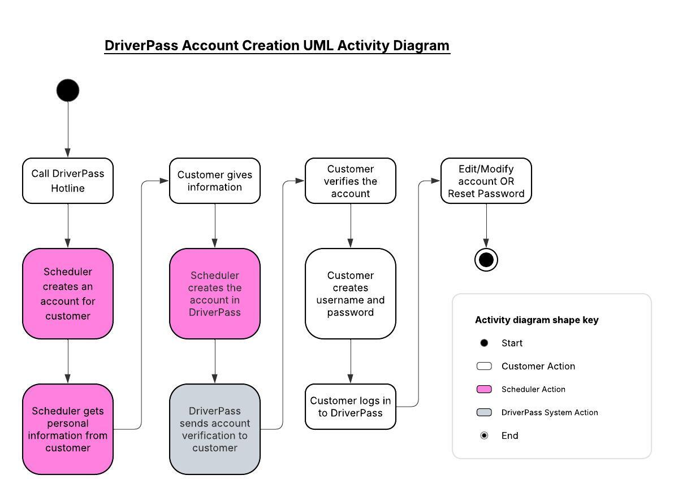
Activity Diagram
Notes:
In this slide, I’ll walk through the main activities involved in the Account Creation use case.
This process outlines how a new customer gets set up in the DriverPass system.
The account creation process begins when the customer calls the DriverPass hotline to request a new account.
From there, the scheduler collects the required information such as the customer’s name, contact details, and package selection, and creates the account on their behalf.
Once the account is created, the customer receives an email verification link. This step ensures that the email address is valid and that the customer is the rightful owner of the account.
After verifying their email, the customer sets up their username and password.
At that point, the customer can log in to the DriverPass system for the first time. From there, they can edit or update their account information, and they can also use the password reset feature if they ever need to recover access.
Overall, this use case ensures that every customer is onboarded securely and consistently, with verification steps in place to protect their account and personal information.

Slide 5
Security
Login requires an email address and password.
System Data is stored in the cloud where all data activity uses the latest security technology.
Accounts will get locked out after multiple failed login attempts.
Reset / Forget password will require an email verification.
Notes:
Security is a critical part of the DriverPass system, especially because we’re handling personal information, scheduling data, and training records. The platform uses several layers of protection to keep user accounts and system data safe. First, the system requires users to log in using a valid email address and password.
This ensures that every user has a unique identity tied to their account.
To prevent unauthorized access, the system automatically locks an account after multiple failed login attempts. This helps protect against brute‑force attacks or repeated guessing.
Second, if a user forgets their password, the reset process requires email verification.
This adds an extra layer of security by ensuring that only the legitimate account owner can initiate a password change.
Third, all system data is stored in the cloud, where modern security technologies are used to protect data in transit and at rest.
This includes encryption, secure communication protocols, and continuous monitoring.
Using cloud‑based infrastructure also helps ensure reliability, scalability, and consistent security updates.
Together, these security measures help ensure that DriverPass maintains the confidentiality, integrity, and availability of user data while providing a safe and trustworthy experience for both customers and staff.

Slide 6
System Limitations
Policies and procedures are dependent on DMV ONLY.
System and services are all hosted in cloud and if cloud service goes down, System and services also go down.
Development timeline might affect future updates.
Budget constraints might affect development progress and limit feature updates.
The system does not detect fraud detection for payments.
Since cloud hosting is used, scaling up might increase depending on system usage and cause higher costs.
Notes:
To wrap up, I want to highlight some of the limitations of the DriverPass system.
These are important to acknowledge because they help set realistic expectations for what the system can and cannot do at this stage of development.
First, the system is fully dependent on the DMV for policies, procedures, and test content. That means any delays or changes on the DMV side directly affect DriverPass.
The system can only be as up‑to‑date as the information provided by the DMV.
Next, the entire platform is hosted in the cloud. While this gives us scalability and reliability, it also means that if the cloud provider experiences downtime, the DriverPass system goes down as well.
There’s no local fallback.
Another limitation involves development resources.
Budget constraints can slow down development or limit the number of features that can be added in future versions.
The timeline for building new features or enhancements may impact how quickly updates can be released.
At this stage, the system does not include built‑in fraud detection for payments.
That means DriverPass would need to rely on the security features of the payment processor rather than having its own fraud‑monitoring capabilities.
Finally, while cloud hosting allows the system to scale as usage grows, scaling up also increases operational costs.
As more users join or system activity increases, the cost of cloud resources will rise accordingly.
These limitations don’t prevent the system from meeting its core goals, but they do highlight areas that may require future investment, planning, or risk management as DriverPass continues to grow.

